Slide 1
Recent Developments in Materials Science
NKS and the design of new materials

Slide 2
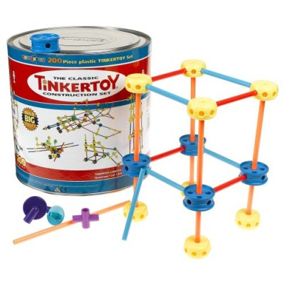
Materials Science for Dummies

Slide 3
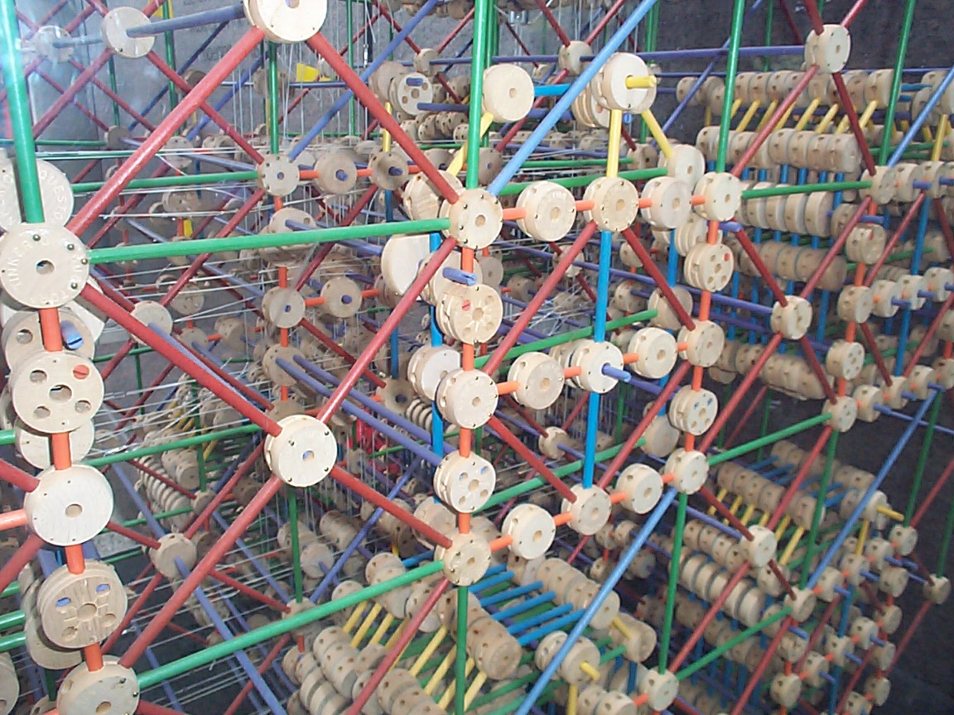
Tinkertoy computer

Slide 4
Crystal Engineering
Node & spacer
Appropriate symmetry
Rigid spacer
“Complete” coordination sphere
“Self-correction”
Thermodynamics
Kinetics

Slide 5
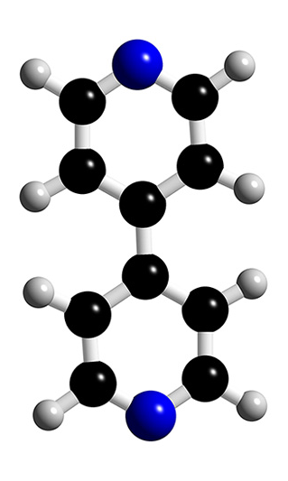
Crystal Engineering

Slide 6
NKS 2006

Slide 7
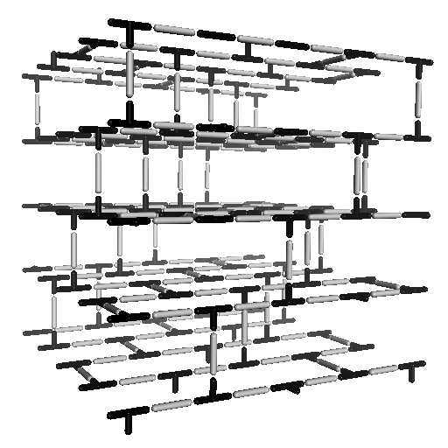
NKS 2006

Slide 8
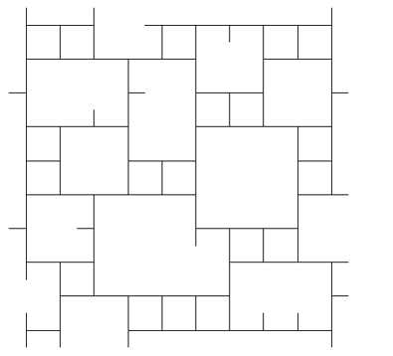
NKS 2006

Slide 9
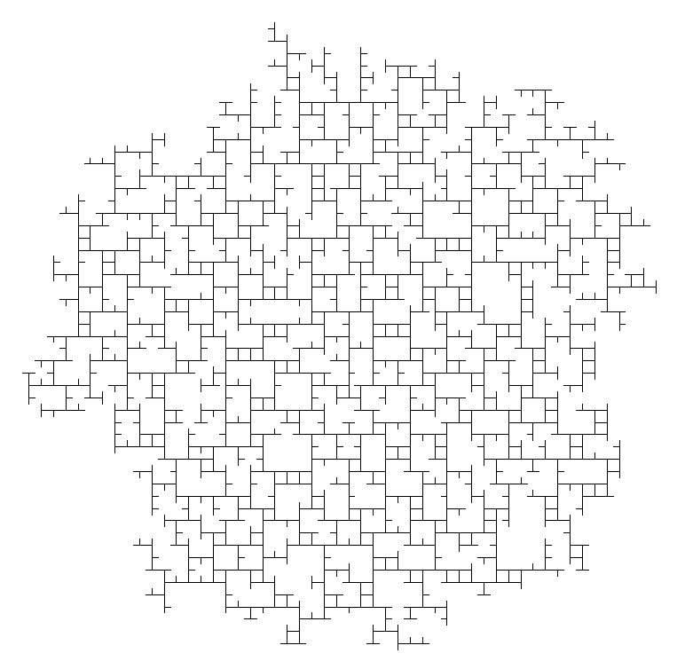
NKS 2006

Slide 10
Amorphous Materials?
Node & spacer
Specific geometries
Rigid spacer
“Complete” coordination sphere
“Self-correction”
Thermodynamics
Kinetics

Slide 11
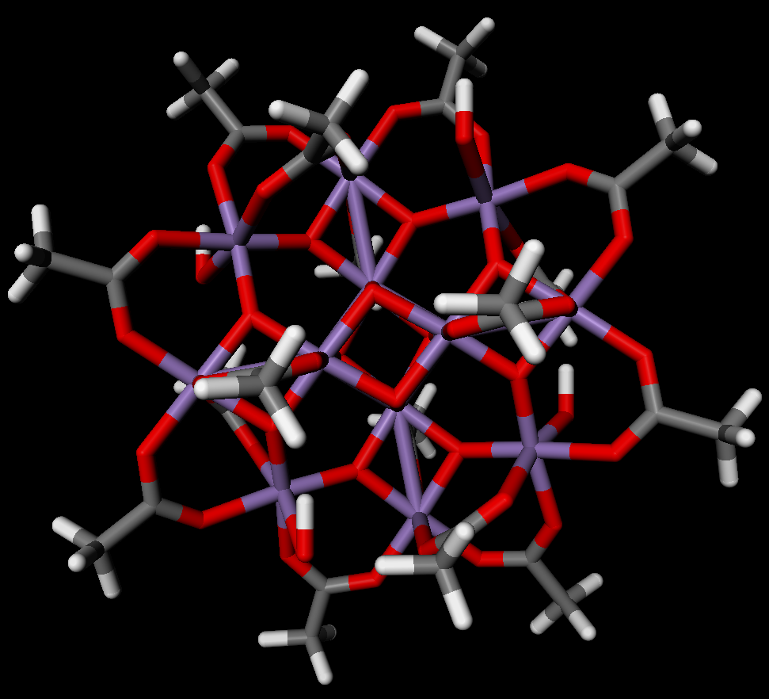
Amorphous Materials?
Mn₁₂O₁₂(CH₃COO)₁₆(H₂O)₄

Slide 12
Ligand Exchange

Slide 13
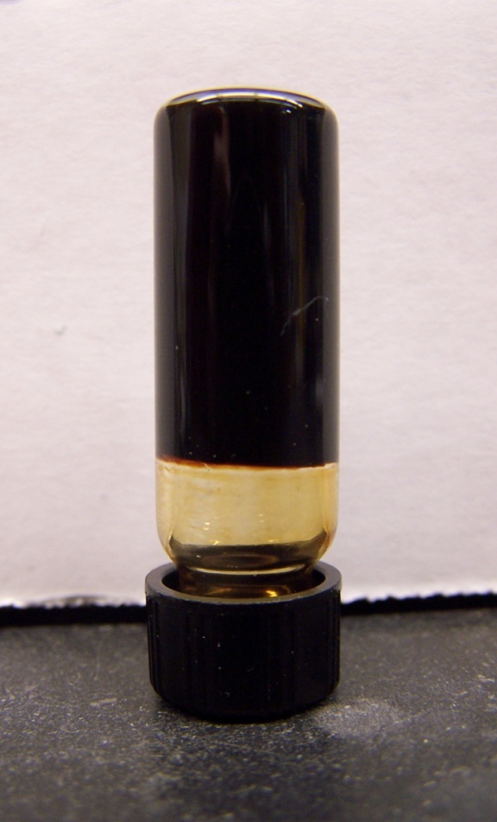
Coordination Polymer Gels
> 95% solvent, by mass
Chem. Commun., 2007, 2802.

Slide 14
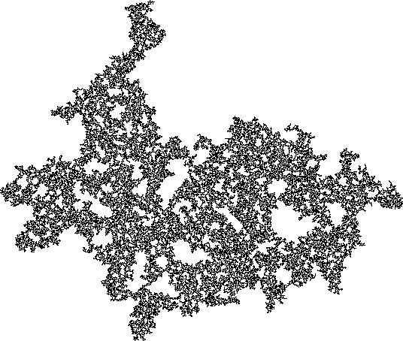
Coordination Polymer Gels
Chem. Commun., 2007, 2802.

Slide 15
Sol-gel Structure
100X optical image

Slide 16
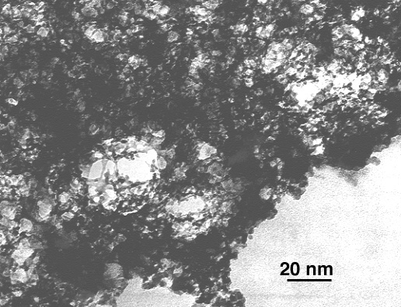
Silica sol-gel
TEM image

Slide 17
Xerogel (films)

Slide 18
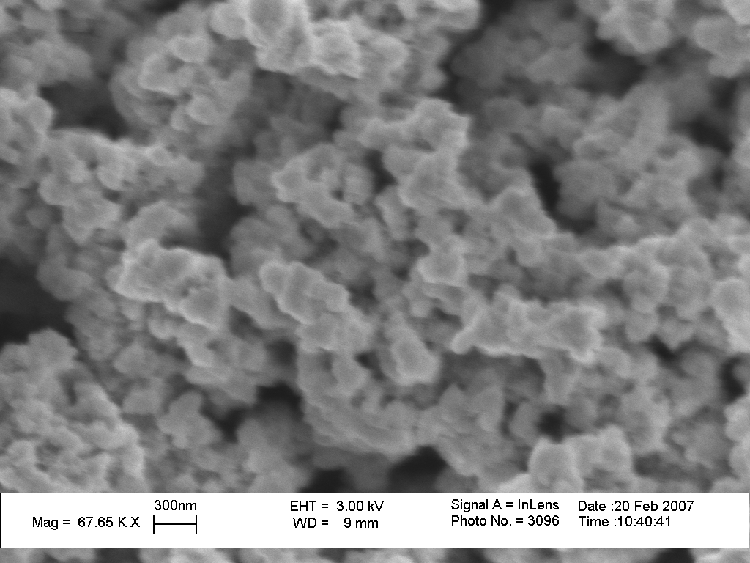
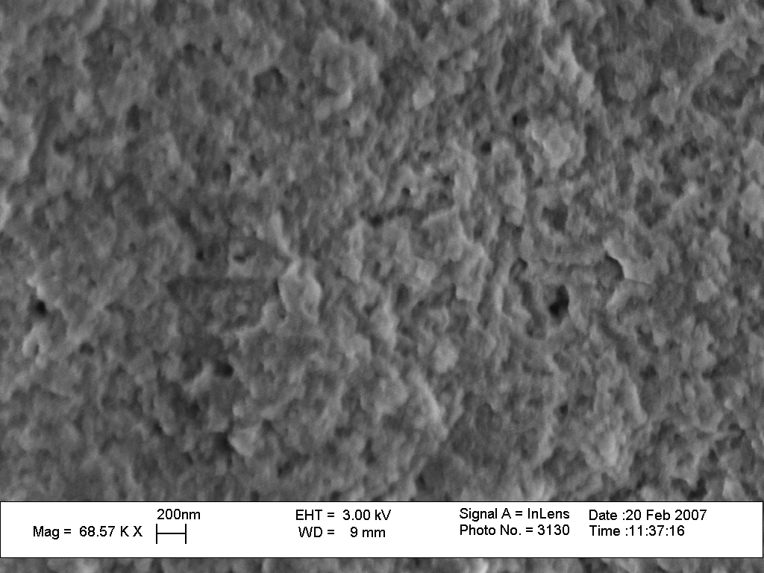
Xerogel (films)

Slide 19
Aerogels
Langmuir surface area = 491 g/m²

Slide 20
Aerogels

Slide 21
Aerogels
Log V = C + (D-3)[Log Log(Po/P)]

Slide 22
Aerogels
Plot 1
Order 1
Curve 1:
Coefficients:
b[0] 1.9299056529
b[1] -0.4804483923
r ² 0.9967341317
Fractal Dimension = 3 + b1
= 2.52

Slide 23
Porous Coordination Polymers
Challenges*
Cooperative properties / composite materials
Thin layer compounds
Mesoscale compounds
*Kitagawa, et al., Angew. Chem. Int. Ed., 2004, 43, 2334-2375

Slide 24
Coordination Polymers Gels
Composite materials
Xerogels: thin layer compounds
Aerogels: mesoporosity
Modular design
Processability
Multiple synthetic approaches

Slide 25
Acknowledgements
Shuangbing Han
Brian Luisi
Kevin Rowland
Brown CAMR
SEM
Indrek Kuloats
adsorption isotherms
Kate Manley
microscopy
Arkwright Incorporated of Coventry, R.I. (USA)
rheometry

